Slide 1
Application Note for 2 Stage CMOS OPAMP (avsdopamp_3v3) By Mrs. Madhuri Hemant Kadam

Slide 2
Application Note-1 for op-amp (avsdopamp_3v3)
ILDO
LDO
Bandgap Reference
BIAS
VDD
VLDO
VREF
VLDO
VCM
VCM
IBIAS
IBIAS
VINP
Instrumentation Amplifier
Hysteresis comp.
Sensor Signal
VLDO
IAOUT
OUT
IBIAS
VINM
VLDO

Slide 3
Application Note-2 for op-amp (avsdopamp_3v3)
VCM
Sensor Signal
VINP
INSTRU AMP
Opamp_3v3
VLDO
Opamp_3v3
IAOUT
IBIAS
Opamp_3v3
VINM

Slide 4
avsdopamp_3v3 Pin layout and preferred dimensions
100um
avsdopamp_3v3
VDD
VBIAS
VINP
VOUT
280um
VINM
VSS

Slide 5
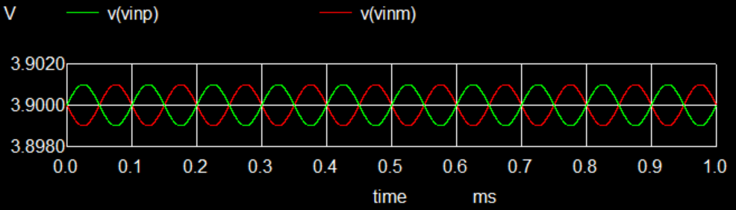
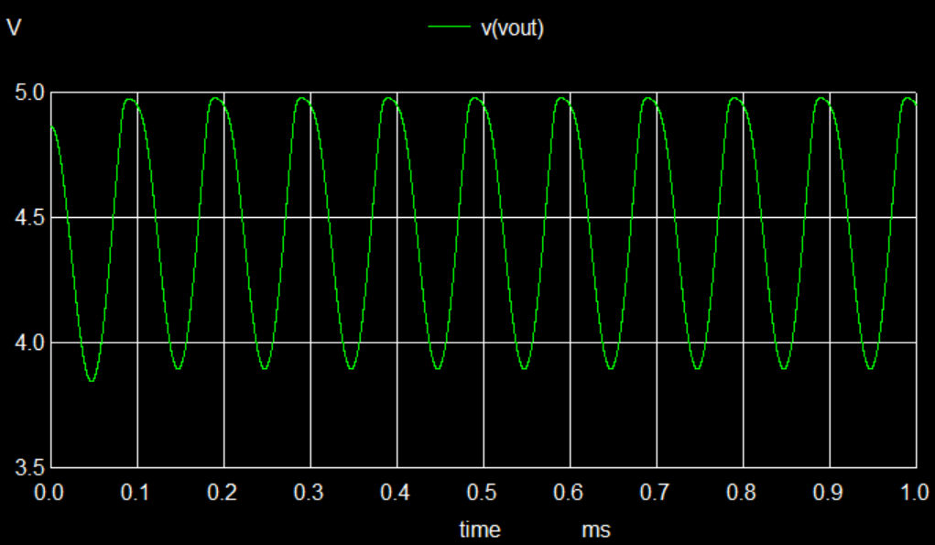
avsdopamp_3v3 Transient Response
20uA ,3.9 V
5V
avsdopamp_3v3
VDD
VBIAS
VINPp-p < 100mv, 0deg ph
VINP
VOUT
VINMp-p < 100mv, 180 deg ph
VINM
VSS

Slide 6
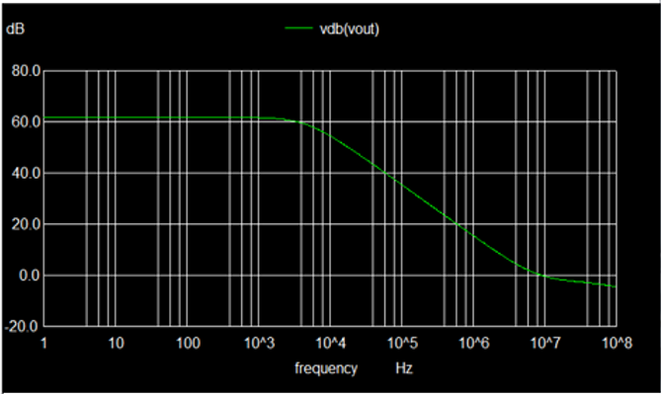
avsdopamp_3v3 Frequency Response
63 dB Open loop gain
5 MHz Unity gain BW
20uA ,3.9 V
5V
avsdopamp_3v3
VDD
VBIAS
VINPp-p < 100mv, 0deg ph
VINP
VOUT
VINMp-p < 100mv, 180 deg ph
VINM
VSS

Slide 7
avsdopamp_3v3 Plots and values needed
CMOS OPAMP Bias voltage VBIAS = 3.9 V with IBIAS = 20 uA
2) OPAMP open loop gain = 63 dB
3) Unity Gain Bandwidth = 5 MHz
4) Common mode rejection ratio (CMRR) = 65 dB
5) Power dissipation = 590 uW

